Slide 1
Coffee Sales Revenue & Financial Performance Dashboard
Prepared by: Atul Pathak, Intern – Elevate Labs Date: 7th August 2025

Slide 2
Objective
To analyz
To analyze coffee sales revenue and performance across locations, product categories, and time periods
To identify key trends in revenue, sales distribution, and order patterns.
To support data-driven decisions for optimizing store operations and marketing strategies.

Slide 3
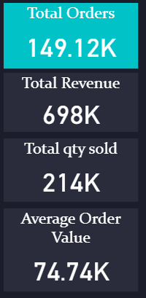
Dashboard
#KPI
Total Orders: 149.12K
Total Revenue: 698K
Total Quantity Sold: 214K
Average Order Value: 74.74K

Slide 4
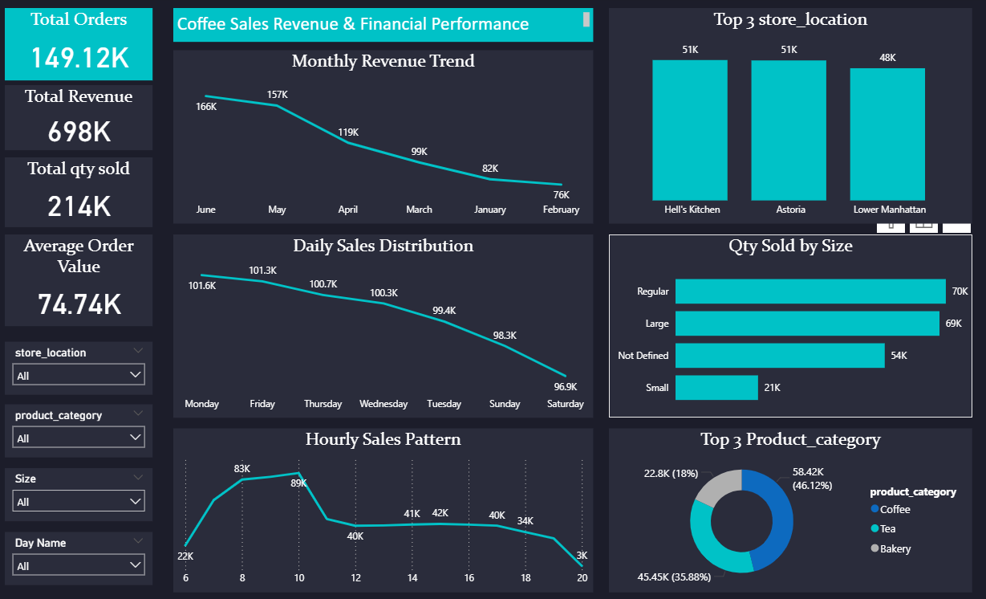
Key Metrics:
Total Orders: 149.12K
Total Revenue: 698K
Total Quantity Sold: 214K
Average Order Value: 74.74K
Key Visuals:
Monthly Revenue Trend
Daily Sales Distribution
Hourly Sales Pattern
Top 3 Store Locations
Quantity Sold by Size
Top 3 Product Categories

Slide 5
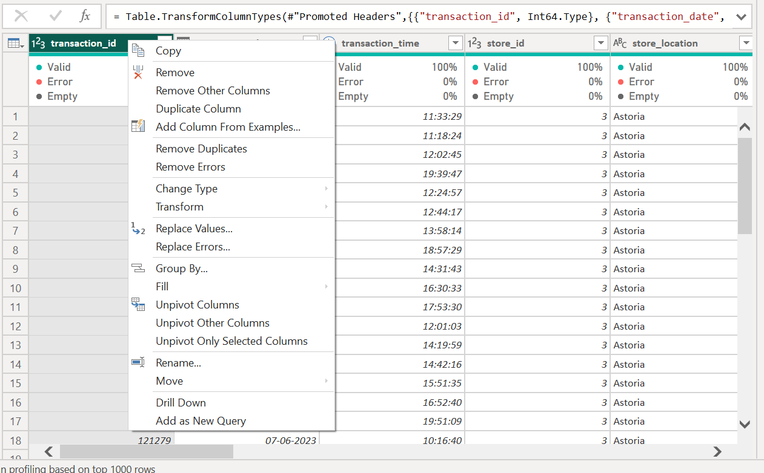
Power Query
Cleaned raw sales data imported from POS systems.
Transformed date and time fields for time-based analysis.
Created calculated columns for Order Value, Revenue, and Size Buckets.
Built relationships between tables: orders, products, and store locations.
Applied filters on store_location, product_category, size, and day name to enable dynamic dashboard interactivity.

Slide 6
All Works
Data Collection: Extracted transaction-level sales data.
Data Preparation: Processed in Power Query with transformations.
Data Modeling: Established relationships in Power BI data model.
Visualizations: Designed charts and KPIs for comprehensive insights.
Interactivity: Integrated slicers for store, product, size, and day filters.
Analysis: Highlighted key findings in sales trends, top performers, and customer preferences.

Slide 7
Summary
Sales performance shows a downward trend in revenue over recent months.
Mondays and Fridays recorded the highest daily sales.
8–10 AM peak hours indicate morning rush as a key sales period.
Hell’s Kitchen and Astoria are the top-performing store locations.
Regular and large sizes are most popular among customers.

Slide 8
Key Insights from the Dashboard
✅Revenue Decline Trend
✅Revenue dropped consistently from 166K in June to 76K in February, signaling an urgent need to investigate causes such as reduced footfall, competition, or seasonal factors.
✅Strong Morning Sales
Hourly sales pattern shows highest activity between 8-10 AM (83K-89K), indicating most customers buy in the morning. Leveraging this with breakfast combos or loyalty offers could further boost sales.

Slide 9
✅ High-Performing Days
Monday and Friday lead with daily sales above 100K each; in contrast, Saturday and Sunday sales are lower (under 98K) → opportunities exist to run weekend-specific promotions to balance sales.
✅ Top Store Locations
Hell’s Kitchen and Astoria (51K each) outperform Lower Manhattan (48K). Strategies from these top stores could be analyzed and applied to underperforming locations.
✅ Product Size Preferences
Regular (70K) and Large (69K) sizes dominate sales, while Small (21K) has minimal demand → suggests focusing inventory and marketing on popular sizes.
✅ Product Category Demand
Coffee accounts for nearly half of total sales (46.12%), followed by Tea (35.88%) and Bakery (18%). Coffee is the core revenue driver; however, Tea and Bakery categories also present opportunities for cross-selling.
✅ Quantity Sold and Average Order Value
High total quantity sold (214K) with an average order value of 74.74K indicates customers purchase multiple items per order → bundle deals may increase average transaction size further.
✅ Filters for Deeper Analysis
Dashboard filters allow drilling down into sales by store location, day, product category, and size → ideal for identifying targeted marketing or operational improvements.

Slide 10
questions
What strategies can we implement to reverse declining revenue trends?
Should marketing campaigns target low-performing days or times?
Are there opportunities to expand top-performing products or sizes?

